Slide 1


Sorin ZGURA
E-Mail: szgura@spacescience.ro
http://www.spacescience.ro

Slide 2

What is ISS?

Slide 3
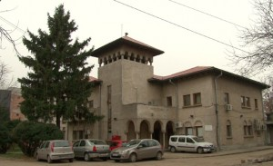
INSTITUTE OF SPACE SCIENCE
legal subsidiary of the
National Institute for Laser, Plasma and Radiation Physics (INFLPR)
(http://www.spacescience.ro)

Slide 4
What is ISS history?

Slide 5
Short history
1956 ÷ 1977
Cosmic Ray Laboratory
Institute for Atomic Physics, Bucharest
1977 ÷ 1990
Center of Astronomy and Space Sciences
Institute for Atomic Physics, Bucharest
1990 ÷ 1996 → strategy: involvement in big international projects
Institute for Gravitation and Space Science, Institute for Atomic Physics, Bucharest
1996 ÷ present
Institute of Space Science subsidiary of the
    National Institute for Laser, Plasma and Radiation Physics, Bucharest

Slide 6
What is the ISS structure?

Slide 7
ISS Structure
  Laboratories
  High Energy Astrophysics and Advanced Technologies
  Cosmology and Astroparticle Physics
  Theoretical Physics
  Space Plasma and Magnetometry Group
  Applications of space and communicational technology for society
  Gravity, microgravity and nanosatellites

Slide 8
Lab: Theoretical Physics
Head of the Lab : Cecil Pompiliu GRUNFELD
Research topics:
Atomic and molecular processes
Kinetic theory of complex systems, exactly solvable models
Space-time structures and symmetries in General Relativity

Slide 9
Lab: Cosmology and Astroparticle Physics
Head of Lab: Lucia Aurelia POPA
Research topics:
Early Universe; Cosmic Microwave Background; Dark Matter ;Dark Energy; Modified Gravity; ESA Space Missions: Planck, EUCLID, CoRE
Neutrino astronomy: ANTARES and KM3NeT; Gamma-Ray Astronomy;
Development of neutrino telescopes.
Galactic Physics; Black holes; Neutrino astrophysics.
Cosmic Rays: exotic particles

Slide 10
Lab: High Energy Astrophysics and Advanced Technologies
Head of the Lab: Titi PREDA
Research topics:
Large Hadronic Collider, High Energy Physics, Quantum Chromodynamics, Quark Gluon Plasma, Heavy-ions, Relativistic heavy-ion collisions, Quark deconfinement, quark-gluon plasma production, phase transition
Nuclear Experiment, few body system, relativistic radioactive beam Astrophysics - High Energy Astrophysical Phenomena, cosmic ray observatory
GRID Computing, HPC, GPU, clustering, embedded systems

Slide 11
Lab: Space Plasma and Magnetometry Group;
Head of the Lab: Octav MARGHITU
Research topics:
Solar-terrestrial interactions;
Fundamental processes in collisionless plasma disturbances in geospace and connections to the Earth;
Hardware development and software tools;

Slide 12
Lab: Applications of space and communicational technology for society
Head of the Lab: Vlad VALEANU
Research topics:
Spatial & Communicational Technologies Applications in the Society Benefit
Ground mobile telemedicine applications with satellite communication covering the diagnostic and curative dimension and the support in crisis situations, disasters, etc.
Applications aiming counter-measures at the adverse effect of space environment due to micro-gravitation
Data mining applications for satellite image time series (SITS) analysis aiming detection and characterization of evolutions

Slide 13
Lab: Gravity, microgravity and nanosatellites
Head of the Lab: Marius-Ioan PISO
Research subjects:
Gravity & orbits
Nano-satellites
Space Weather
Earth observation

Slide 14
What are the ISS Strategic Goals

Slide 15
STRATEGIC SCIENTIFIC OBJECTIVES AND DIRECTIONS
O1. Involvement in ground-based experiments of national and international interest.
D1.1 Neutrino astrophysics, multi-messenger astronomy with neutrinos, gamma and ultrahigh energy cosmic rays (participation at ANTARES, KM3NeT, DWARF, Pierre Auger Observatory).
D1.2 Search of exotic particles and phenomena in cosmic rays and colliders/accelerators beams (participation at ANTARES, KM3NeT, LHC-ALICE-CERN, MoEDAL – CERN, NUSTAR-FAIR-GSI, ILC, NICA-JINR DUBNA, NUCLOTRON-JINR DUBNA).
D1.3 Innovative particle detection techniques with applications to large scale ground-based experiments (e.g. FCAL).
D1.4 Search for astronomical and astrophysical signatures of Weak Equivalence Principle (WEP) violations.
Notes:
The main objectives of the ISS strategic development plan revolve tightly around its stated mission, namely that of further increasing its scientific performance, standing and recognition within the space science and technology community through participation in and initiation of national and international projects.
The strategic development plan is based on a core of 5 strategic objectives that emerge from the scientific SWOT analysis presented in the previous section. Each of these objectives is supported by appropriate key scientific activities which represent the milestones of the ISS future development.

Slide 16
STRATEGIC SCIENTIFIC OBJECTIVES AND DIRECTIONS
O2. Involvement in satellite space missions of international interest.
D2.1 Investigation of solar system plasmas by satellite observations (e.g. by participation to the ESA missions Cluster, Venus Express, Swarm, Solar Orbiter and to the NASA missions THEMIS and MMS).
D2.2 Participation to ESA scientific missions for the search of dark matter, dark energy and modified gravity (PLANCK, EUCLID, CoRE)
Notes:
The main objectives of the ISS strategic development plan revolve tightly around its stated mission, namely that of further increasing its scientific performance, standing and recognition within the space science and technology community through participation in and initiation of national and international projects.
The strategic development plan is based on a core of 5 strategic objectives that emerge from the scientific SWOT analysis presented in the previous section. Each of these objectives is supported by appropriate key scientific activities which represent the milestones of the ISS future development.

Slide 17
STRATEGIC SCIENTIFIC OBJECTIVES AND DIRECTIONS
O3. Involvement in the International Space Station
exploitation as a space platform for scientific and technological experiments.
Notes:
The main objectives of the ISS strategic development plan revolve tightly around its stated mission, namely that of further increasing its scientific performance, standing and recognition within the space science and technology community through participation in and initiation of national and international projects.
The strategic development plan is based on a core of 5 strategic objectives that emerge from the scientific SWOT analysis presented in the previous section. Each of these objectives is supported by appropriate key scientific activities which represent the milestones of the ISS future development.

Slide 18
STRATEGIC SCIENTIFIC OBJECTIVES AND DIRECTIONS
O4. Development of space science technology facilities.
D4.1 Development of satellite instrumentation.
D4.2 Development and integration of microsatellites for space applications (GOLIAT).
D4.3 Development of a competitive integrated satellite ground testing facility.
D4.4 Development of a competitive satellite missions and communication centre.
D4.5 Development of a comprehensive testing and simulation facility for human space flight countermeasures.
Notes:
The main objectives of the ISS strategic development plan revolve tightly around its stated mission, namely that of further increasing its scientific performance, standing and recognition within the space science and technology community through participation in and initiation of national and international projects.
The strategic development plan is based on a core of 5 strategic objectives that emerge from the scientific SWOT analysis presented in the previous section. Each of these objectives is supported by appropriate key scientific activities which represent the milestones of the ISS future development.

Slide 19
STRATEGIC SCIENTIFIC OBJECTIVES AND DIRECTIONS
O5. Development and improvement of a strong computational and theoretical infrastructure to support the strategic plan objectives:
D5.1 Development and improvement of large scale High Performance Computing (HPC) facilities for high energy physics, space science, astrophysics, and applications (e.g. GRID sites for the ALICE-CERN Collaboration, GPU computing, ESA-PLANCK, FAIR-NUFAR-GSI).
D5.2 Stronger involvement in the study and numerical modelling of complex processes and structures in theoretical astrophysics, gravitation, cosmology, and physics of the violent Universe.
Notes:
The main objectives of the ISS strategic development plan revolve tightly around its stated mission, namely that of further increasing its scientific performance, standing and recognition within the space science and technology community through participation in and initiation of national and international projects.
The strategic development plan is based on a core of 5 strategic objectives that emerge from the scientific SWOT analysis presented in the previous section. Each of these objectives is supported by appropriate key scientific activities which represent the milestones of the ISS future development.

Slide 20
STRATEGIC SCIENTIFIC OBJECTIVES AND DIRECTIONS
O6. Integration of the ISS activities in national and international space applications of social and strategic interest, with the possibility of technological transfer to public, private and strategic partners:
D6.1 Disaster management.
D6.2 Mobile, in-field, satellite communication telemedicine for critical situations response.
D6.3 Weather surveillance.
D6.4 Remote sensing.
D6.5 Countermeasures to human space flight in adverse conditions
Notes:
The main objectives of the ISS strategic development plan revolve tightly around its stated mission, namely that of further increasing its scientific performance, standing and recognition within the space science and technology community through participation in and initiation of national and international projects.
The strategic development plan is based on a core of 5 strategic objectives that emerge from the scientific SWOT analysis presented in the previous section. Each of these objectives is supported by appropriate key scientific activities which represent the milestones of the ISS future development.

Slide 21
International cooperation
ESA projects
CLUSTER – ESA mission
„Kinetic and Experimental Investigation of Earth’s and Venus plasma layers (KEEV)” – ESA Project
Energy conversion and transfer in the solar wind - magnetosphere - ionosphere system (ECSTRA) - ESA/PECS project
Planck – ESA mission
“Coloured Fungi in Space – CFS” – ESA/SURE Project
“Romanian GRID middleware repository for Space Science Applications” - ESA/PECS project
“Portable Telemedicine Workstation Definition and Specification– PTW” – ESA/PECS Project
“EUCLID” – ESA mission
„Cosmic Origins Explorer – COrE” – A proposal in response to the ESA Cosmic Vision 2025 (the Institute for Space Sciences is co-author).

Slide 22
Projects at the big European facilities
ALICE – CERN, Geneva
R3B – FAIR-GSI-Darmstadt, Germany
“BEQUEREL” – IUCN-Dubna, Russian Federation
“MoEDAL” – CERN, Geneve
MultiPurpose Detector at Nuclotron based Ion Collider fAcility – NICA/MPD – IUCN Dubna, Russian Federation
FCAL @ILC (Forward Calorimeter - International Linear Collider)

Slide 23
European Projects
ANTARES – International Project
Km3Net – FP 7
European cooperation in the field of scientific and technical research - ESSEM – “COST Action ES0803 - „Developing Space Weather products and services in Europe”, 2008-2012
„Balkans, Black Sea and Caspian Sea Regional Network on Space Weather Studies”
„Simulations for Nuclear Reactions and Structure in Europe (SiNuRSE)” - FP7
FCAL – R&D International Collaboration for future detectors for e+ e- linear colliders
ADAMAS (WP16 of HadronPhysics 3), FP7
“Plasma Processes in the Solar Wind-Magnetosphere-Ionosphere System”, cooperation with “Jacobs University Bremen - School of Engineering and Science”, Bremen, Germania.
Plasma coupling in the auroral magnetosphere - ionosphere system (POLARIS) - cooperation with „the International Space Science Institute”, Bern

Slide 24
On-ground experiments
1. Heavy ion experiments in nuclear emulsions
BECQUEREL – “Berilium Clustrering Quest in Relativistic Multifragmentation”, JINR - Dubna, Russia
2. ALICE – “A Large Ion Collider Experiment” –
LHC - Large Hadron Collider, CERN, Geneva
3. FAIR - GSI, Darmstadt:
a) - NUSTAR - R³B – “Reactions with Relativistic Radioactive Beams”
4. SLIM - “Search for LIght Monopoles”, Chacaltaya, Bolivia
5. ANTARES – “Astronomy with a Neutrino Telescope and Abyss environmental RESearch”, Mediterranean See
6. Km3Net – ESFRI
7. MoEDAL – CERN
8. Pierre Auger Observatory
9. International Linear Collider -FCAL

Slide 25

Cosmic Vision
2015 - 2025
ISS Collaborations
EUCLID Mission (SPACE + DUNE)
Cross-Scale Mission: Multi-scale Coupling in Space Plasmas
    1. Cross-Scale Magnetometer
    2. Studies for Cross-Scale Ion Instruments
    3. Studies for Cross-Scale Electron Instruments

Slide 26
What about ISS Outreach?

Slide 27




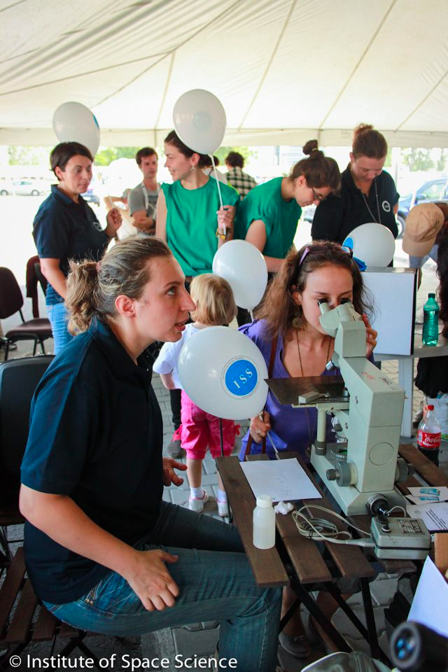

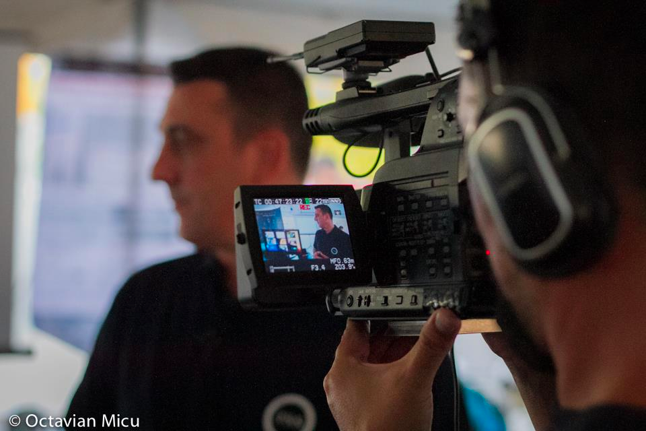
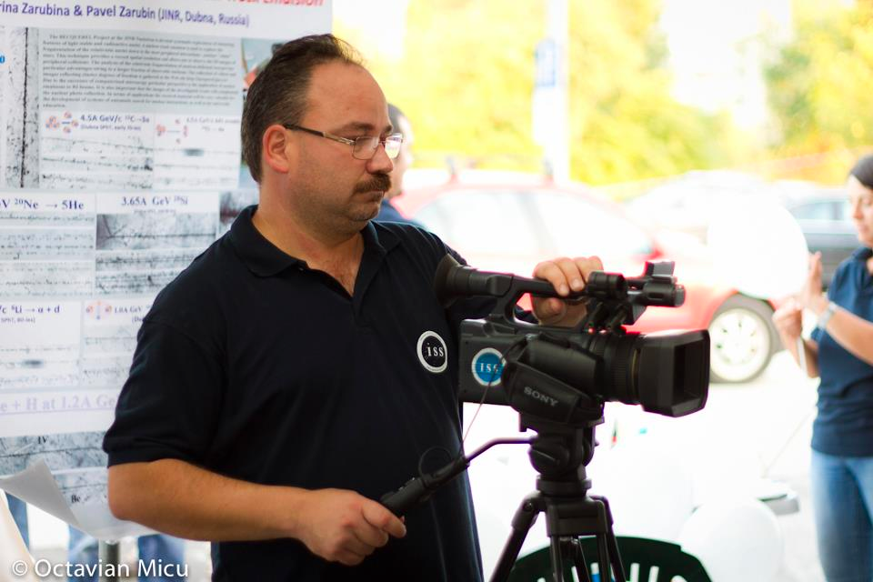
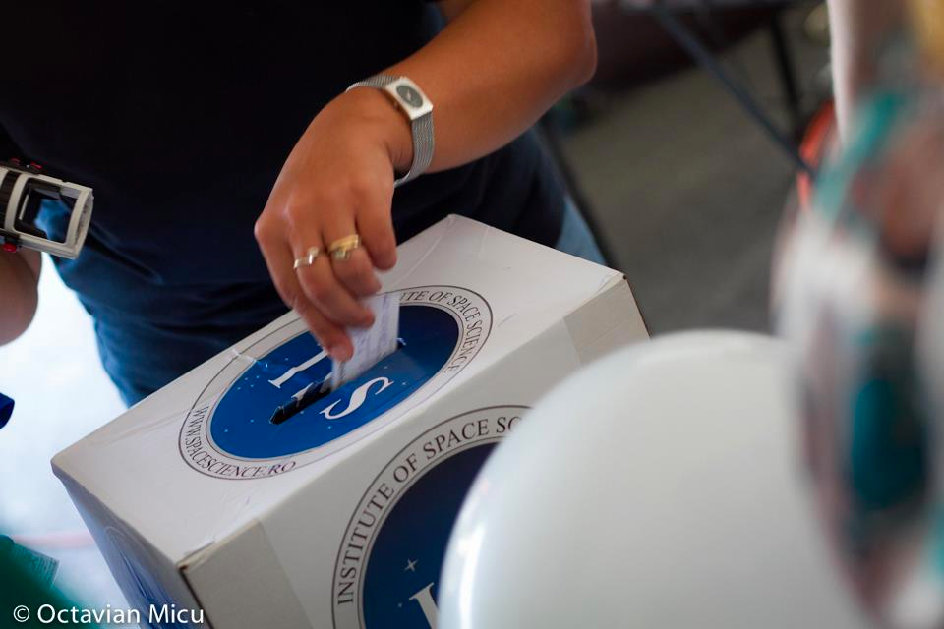


HOW WE ACHIVE PERFORMANCE
Public Outreach

Slide 28
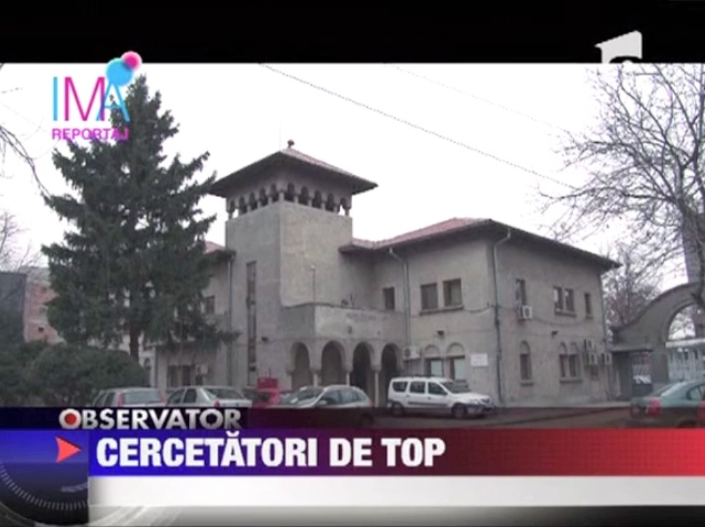
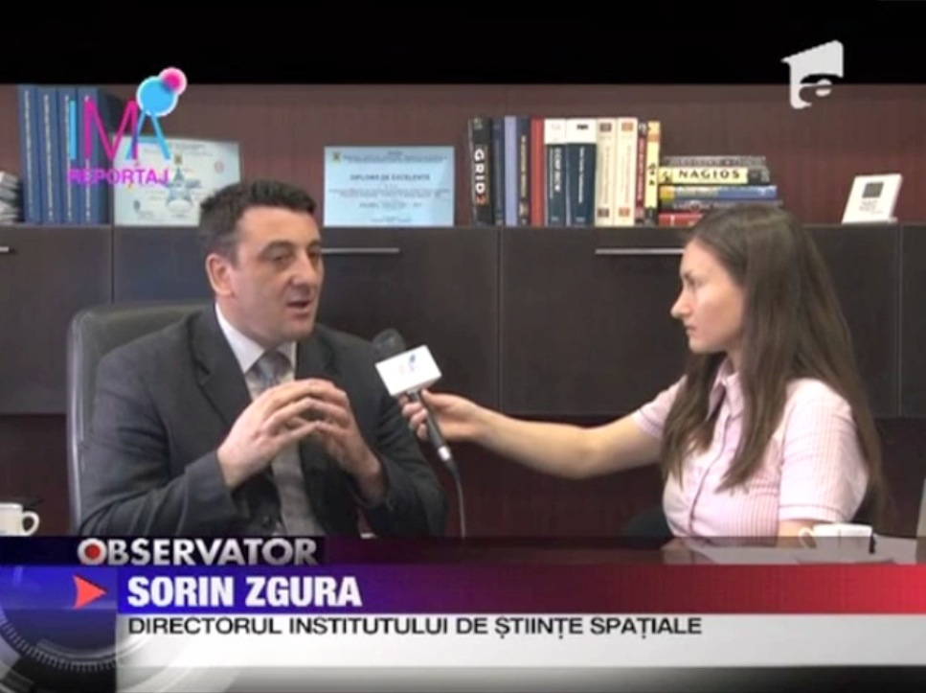
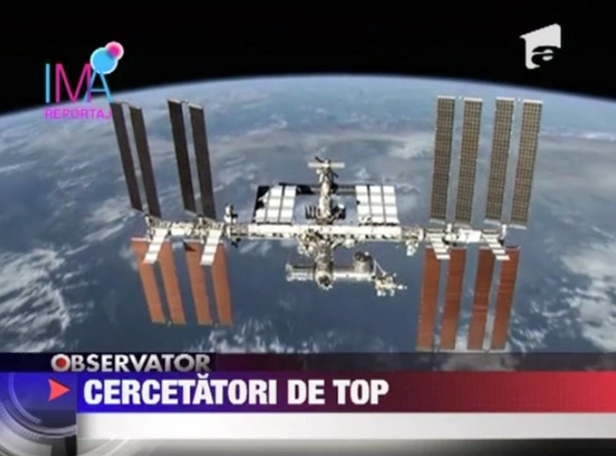
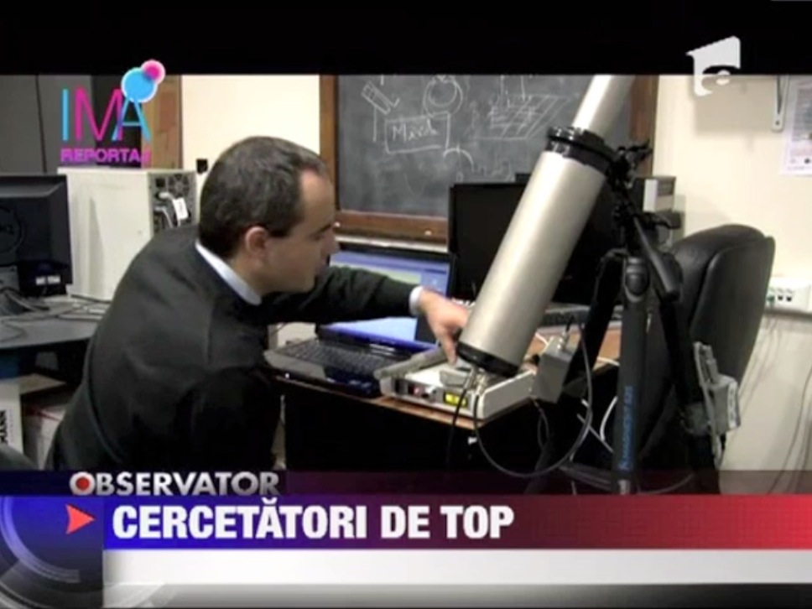
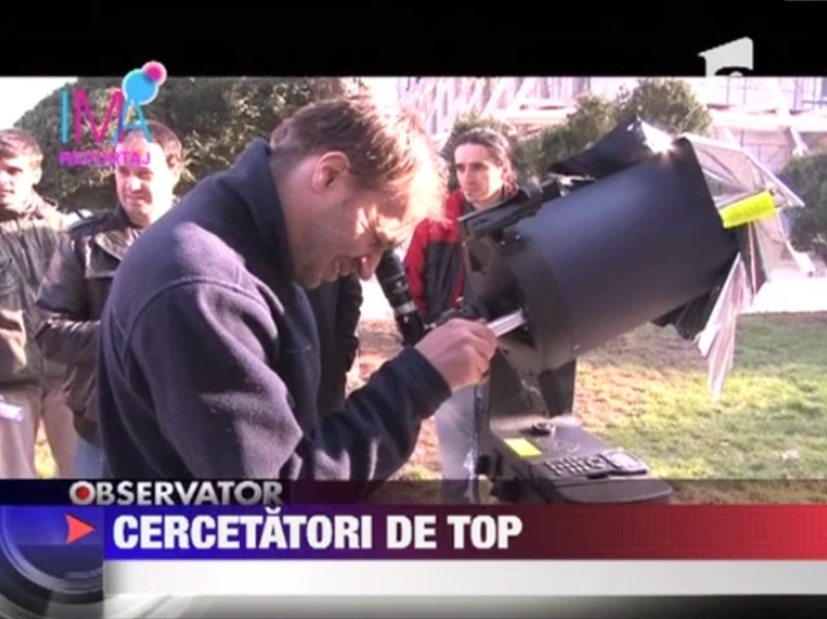
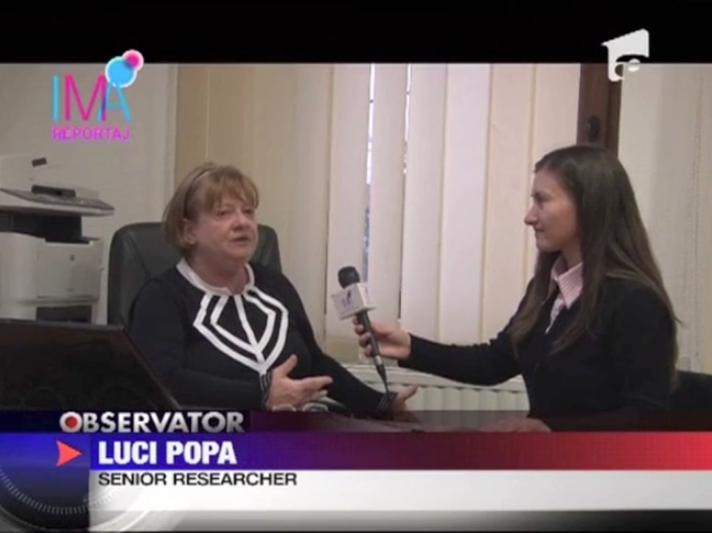
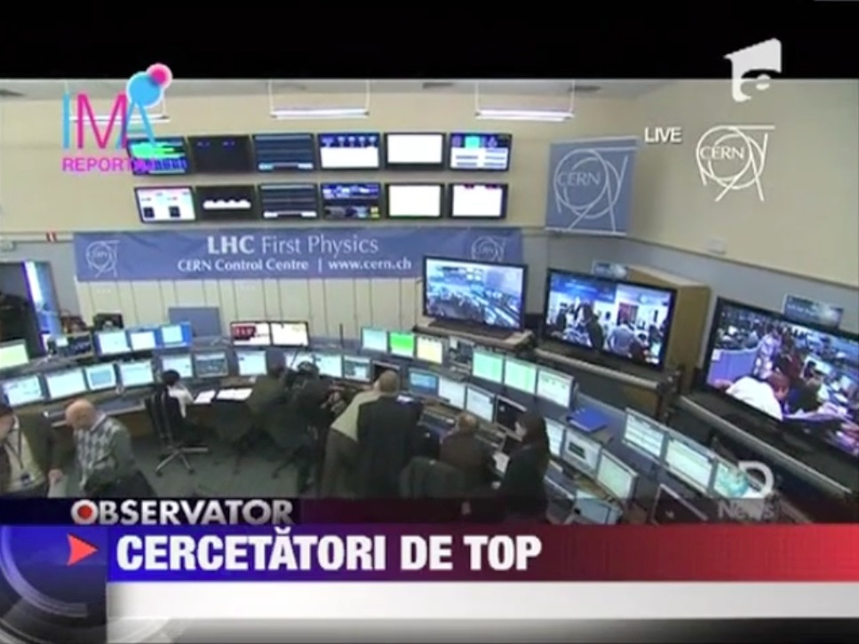
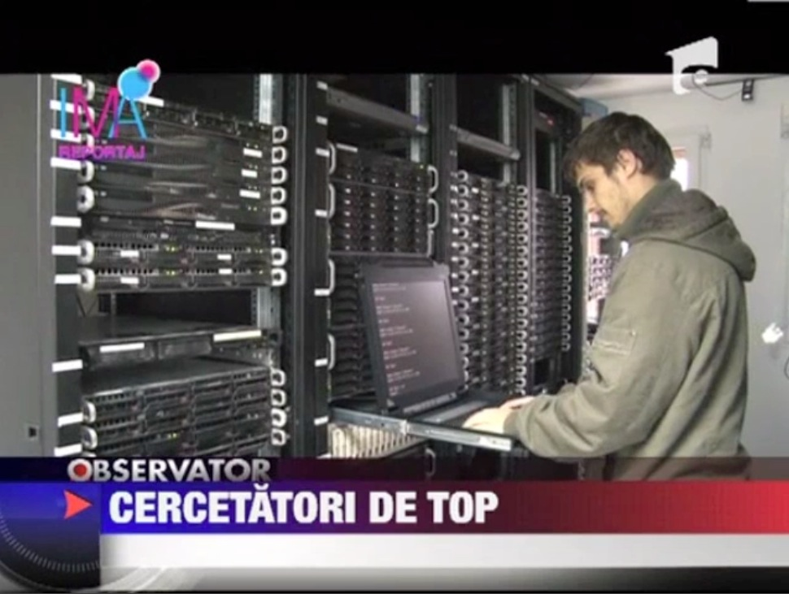
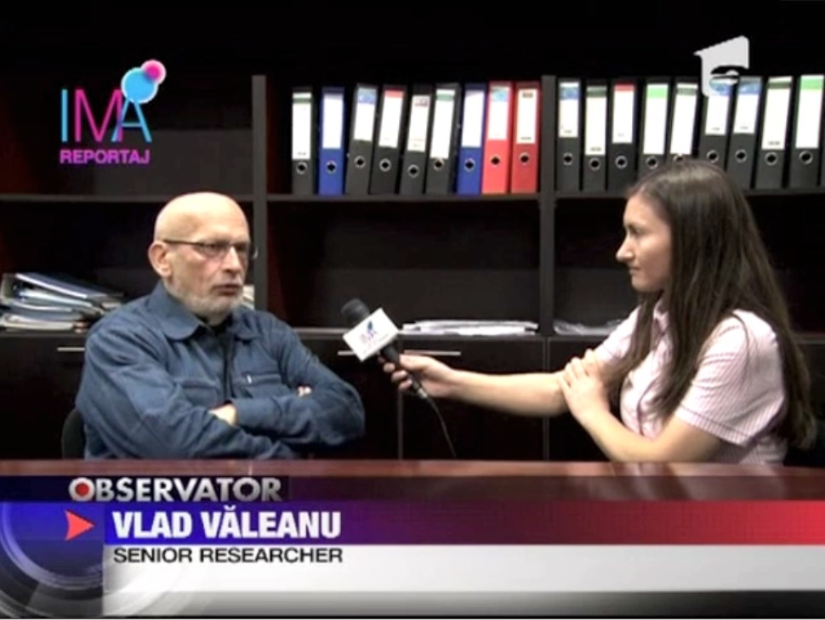
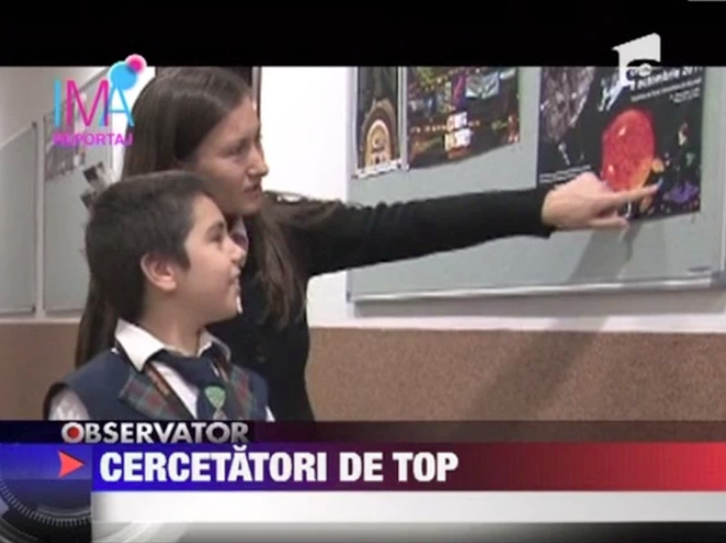

HOW WE ACHIVE PERFORMANCE
Public Outreach
Promotion of the
ISS activities on
TV Antena1 News
Production by ISS team:
-Gina ISAR (reporter TV) and Ovidiu BANARU (cameraman)

Slide 29
What about ISS HR Management?

Slide 30
ISS HR Management
Recruitment –has a critical impact on the performance of ISS (in the frame of international collaborations)
  Positive influx of foreign trained scientists
  Source of Recruitment: Internal or External
  Recruitment Strategies (universities, etc)
Selection
  Effective Employee Selection
Placement
  Assign a specific job/task to each of the selected candidates
Training and Developing HR
Evaluation
  For scientists ( annual evaluation forms)
  Administrative staff ( external audit)

Slide 32
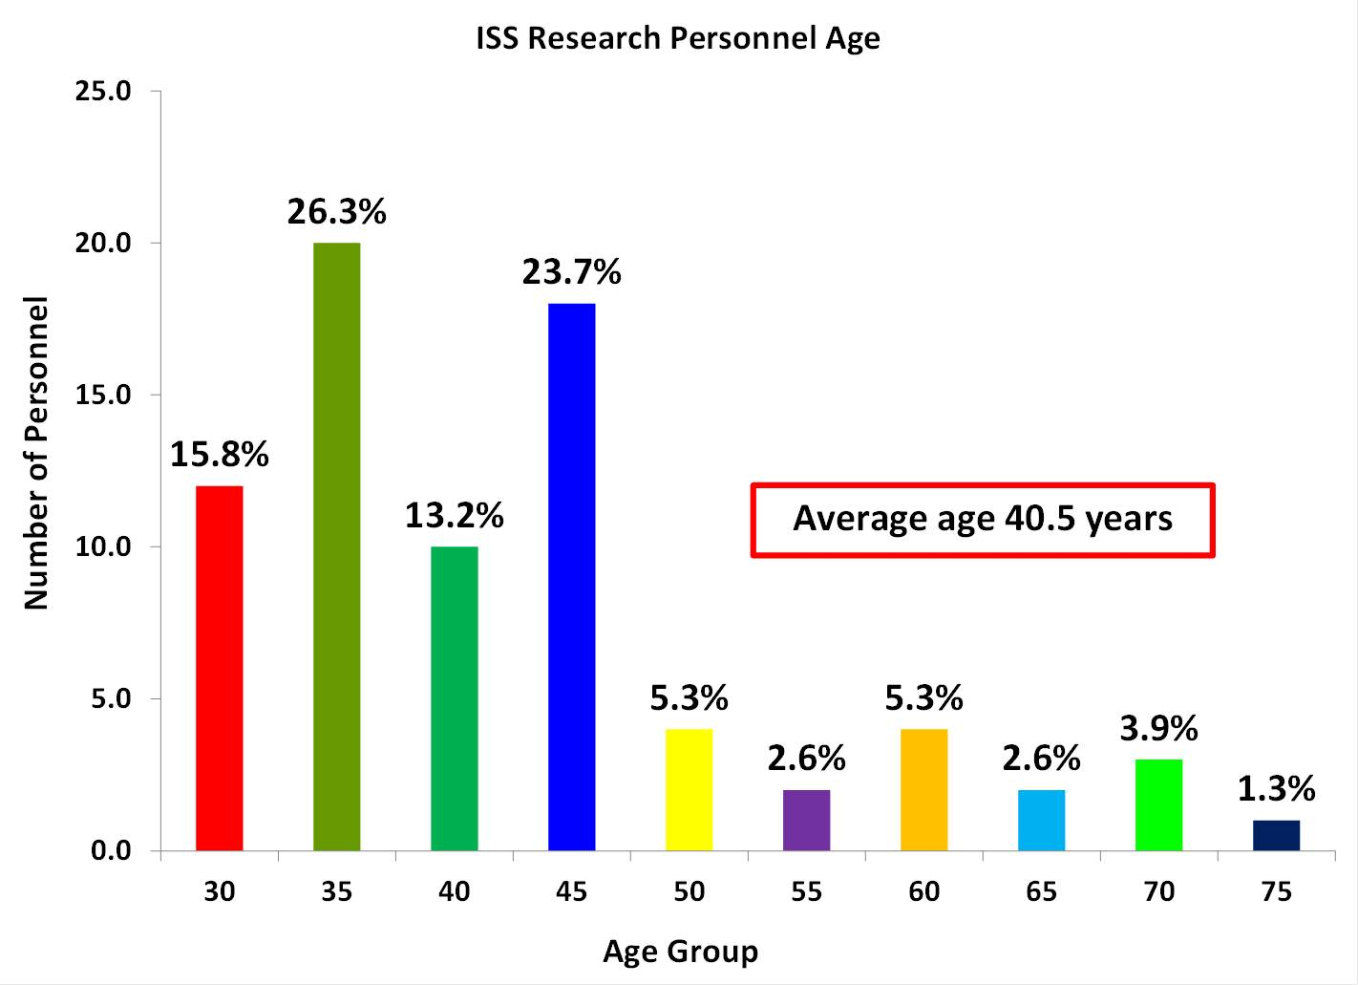
HOW WE ACHIVE PERFORMANCE
RESEARCH PERSONNEL
YOUNG AND DEDICATED

Slide 33
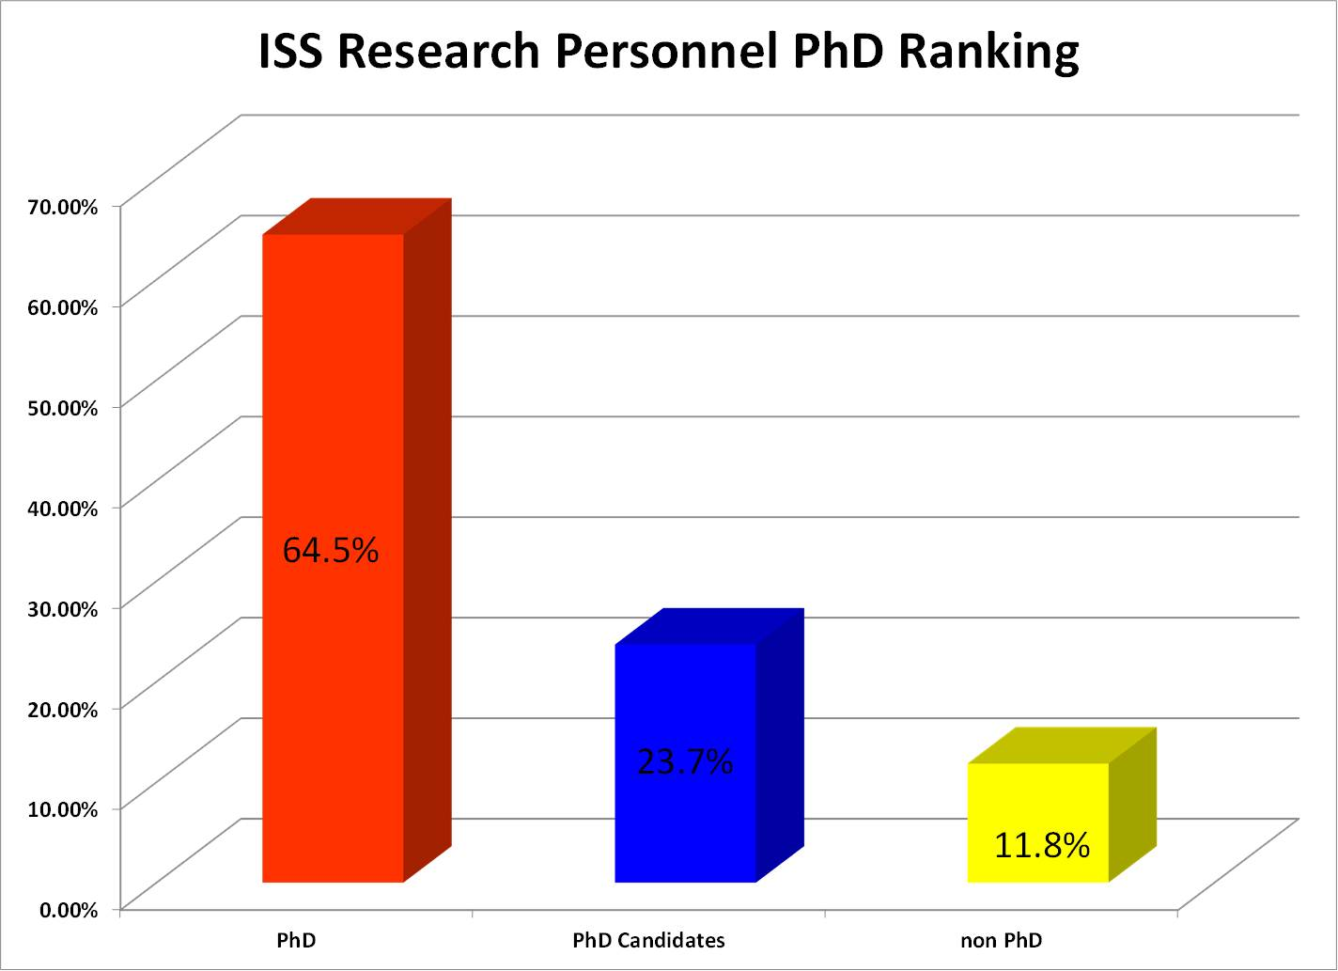
HOW WE ACHIVE PERFORMANCE
RESEARCH PERSONNEL
HIGHLY KNOWLEDGEABLE

Slide 34
HOW WE ACHIVE PERFORMANCE
GENDER DISTRIBUTION OF THE RESEARCH PERSONNEL
HIGHLY KNOWLEDGEABLE

Slide 35
HOW WE ACHIVE PERFORMANCE
RESEARCH PERSONNEL
HIGHLY EXPERIENCED
ACS –Scientific Research Assistant
CS - Scientific Researcher
CS3 - Scientific Researcher 3rd degree
CS2 - Scientific Researcher 2nd degree
CS1 - Scientific Researcher 1st degree

Slide 36
GENDER RESEARCH PERSONNEL
HIGHLY EXPERIENCED
ACS –Scientific Research Assistant
CS - Scientific Researcher
CS3 - Scientific Researcher 3rd degree
CS2 - Scientific Researcher 2nd degree
CS1 - Scientific Researcher 1st degree

Slide 37
What about ISS Funds

Slide 38
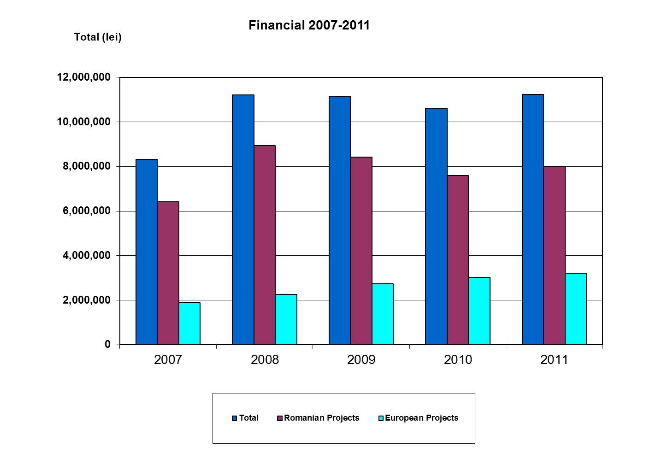
HOW WE ACHIVE PERFORMANCE
ATTRACTION OF FUNDS
Financial Sources:
National R&D Programs
FP 7
PECS-ESA
Other..
Notes:
Slide message:
1. This is our current funding situation.
2. Emphasis on increasing funding levels despite international economic downturn.

Slide 39
What about ISS visibility

Slide 40
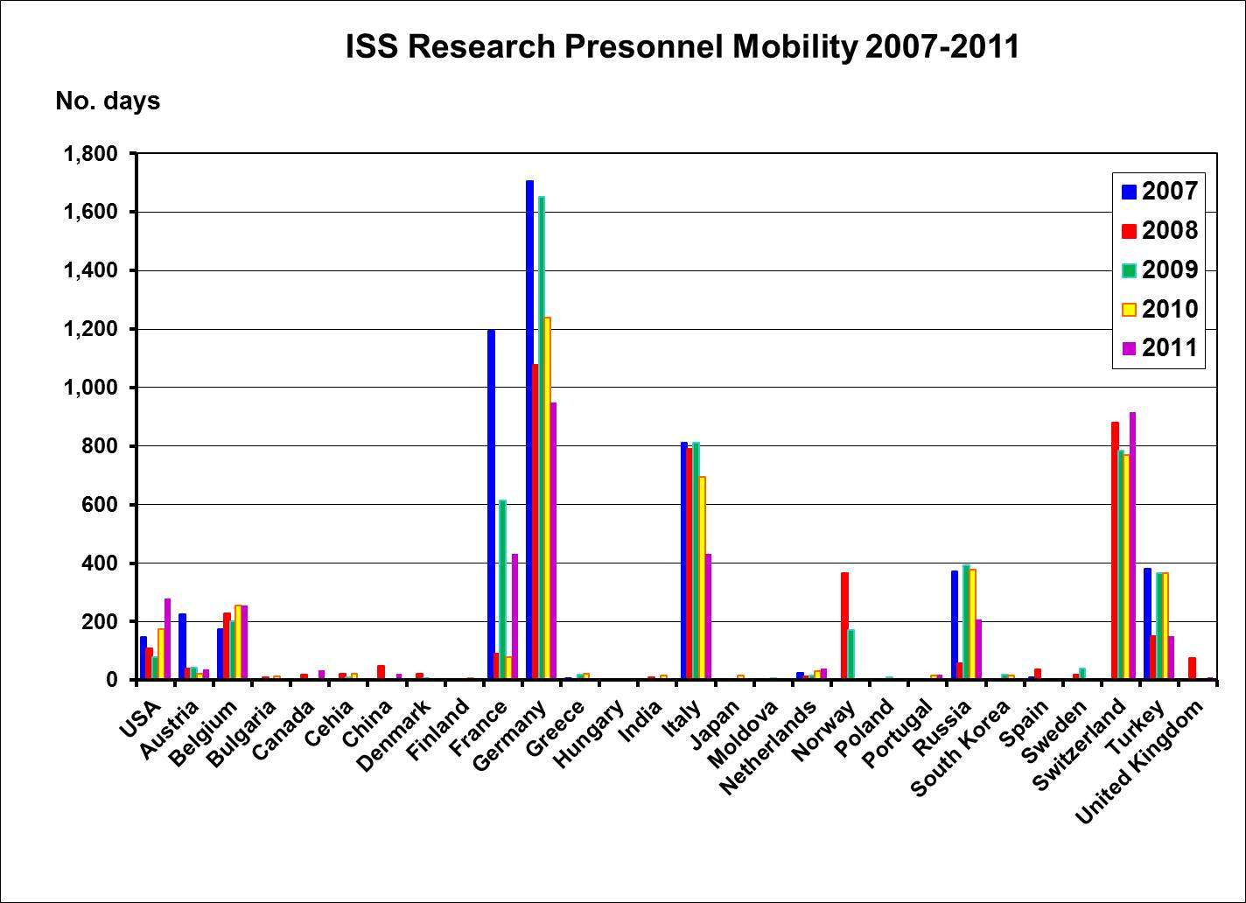
HOW WE ACHIVE PERFORMANCE INTERNATIONAL VISIBILITY
Notes:
Slide message:
1. Visibility means scientific prestige, which means more chances for funding.
2. Emphasis that despite economic downturn, key collaborations have actually developed (e.g. with Germany, Italy, Switzerland and name projects)

Slide 41
What about ISS results

Slide 42
HOW WE ACHIVE PERFORMANCE
QUALITY RESEARCH

Slide 43
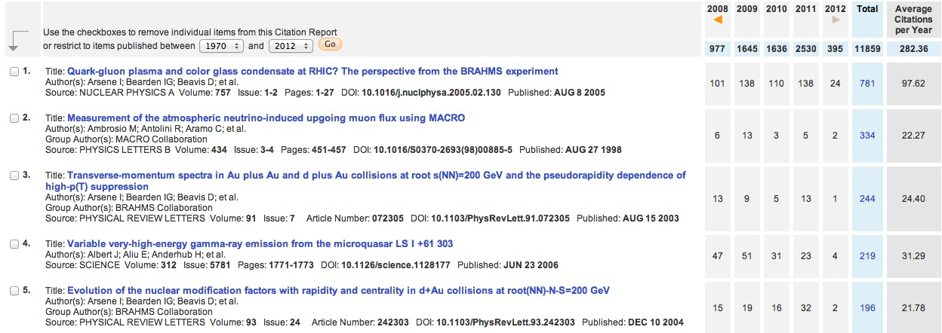
HOW WE ACHIVE PERFORMANCE
QUALITY RESEARCH-HIGH CITATION PAPERS

Slide 44
What about ISS technology development

Slide 45
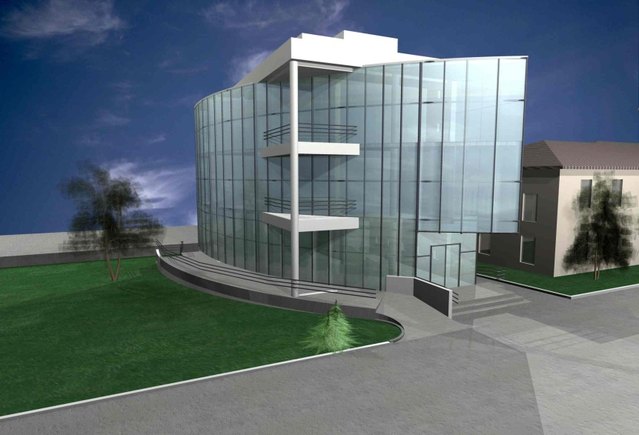
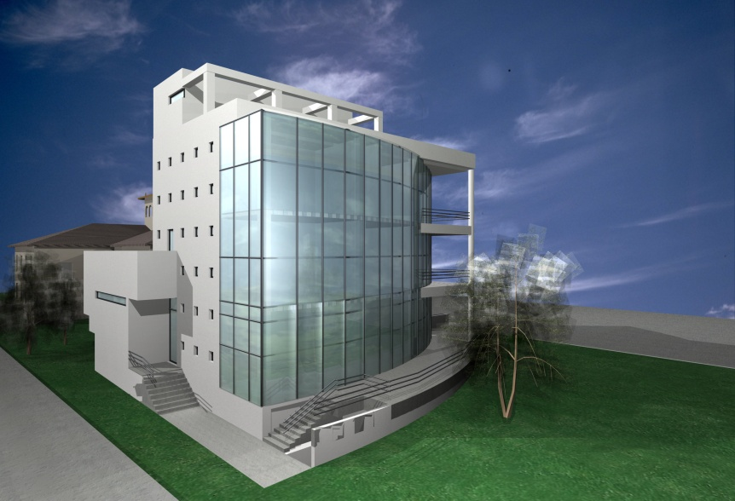
HOW WE ACHIVE PERFORMANCE
TECHNOLOGY DEVELOPMENT
Space Science and Technology Center
Description:
  Basement - Data Center, CleanRoom, Utilities
  1st floor – Electronic lab
  2nd ,3rd floors-Offices
  Technological Roof –telescopes, satellites antenna, space science experiments
Status: under construction
Notes:
Slide message:
1. Unfortunately, effects of economic downturn are visible.
2. However, as soon as the tide turned, we have started to make up for the lost years.
3. On the bright side, we due to technology development in the last years, we can now purchase better equipment.

Slide 46
What are our Managerial Tools

Slide 47
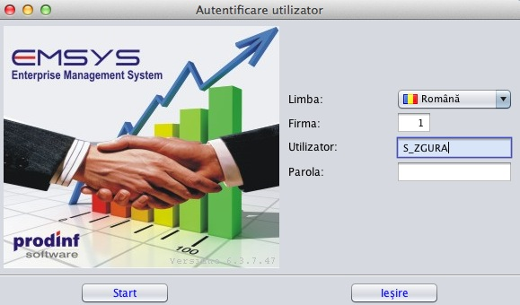
ERP @ ISS
Institute of Space Science has chosen a modern ERP(Enterprise Resource Planning) solution: EMSYS -Enterprise Management System
Components:
HR & payroll
Financial
Logistic
Business Intelligence
Project Management (available end of 2012)
Features:
-Oracle DB
-Java WebStart GUI
-cross platform
(Windows, Linux, Mac OX)

Slide 48

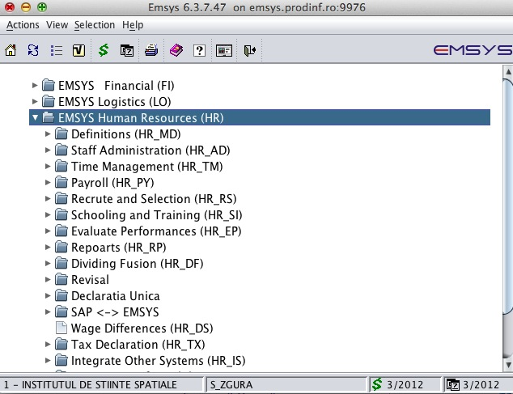
ERP –HR&PayRoll @ ISS
Staff Management
Organization chart
Time Management
Payroll
Recruite and selection
Scholarship and Training
Performances Evaluation
Reports
Tax Declarations and Taxes
Other systems integration: SAP Fl, CO and HR.
Notes:
EMSYS HR : Offers an overview on the situation of human resources and payroll
Staff Management manages staff data: employee identification, place of work, home, labor contracts, seniority, professional training, civil status, family, known foreign languages, military status and the history of unworked periods.
· Organization chart defines the company's organization chart in dynamic way.
· Time Management ensures the management of information regarding worked and unworked time, electronic timesheets systems integration.
· Payroll ensures the company's payroll politics implementing.
· Recrute and selection ensures the management of data regarding staff recrute by modeling data on staff recrute channels, employment requests, information about candidates, recrute agencies, recrute responsibles and staff selection.
· Scholarship and Training allows the management and pick up data regarding the level of studies,
graduated education institutions, specializations, professional and individual training activity of the
employee.
· Performances Evaluation manages data regarding the performance indicators and appreciation of employee activity.
· Reports provides users standard reports, but also the possibility to realize "custom" reports.
· Tax Declarations and Taxes realizes the integration to used electronic applications in taxes collection.
· Other systems integration: it is integrated to EMSYS Financial and allows the integration to other ERP systems: SAP Fl, CO and HR.

Slide 49

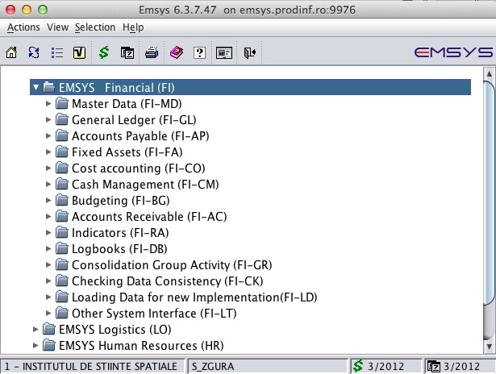
ERP – FI @ ISS
EMSYS Financial offers an overview on the financial situation of the ISS in real time.
Financial Accounting.
Multiple accounting
Accounts Payable/Receivable
Fixed Asset.
Cost Accounting.
Cash Management.
Budgets
Indicators.
Logbooks.
Financial Consolidation.
Notes:
Financial Accounting. The transactions are recorded in a lot of accounting ledgers, organised as to reflect the uniformity of the phenomena and the work division in the organization. Any transaction is recorded in any currency, in the legal currency and, automatically, in other two currencies, reference and consolidation. By configuring the accounts classes there are available: financial accounting, outside balance accounting and the cost accounting.
Multiple accounting supports the companies with a group structure, with statuary reporting and with alternative reportings for the consolidation of the accounting in the mother company. It automatically attains from the financial accounting on the basis of the configurations. The financial reports are automatically obtained for alternative accountings.
Accounts Payable and Accounts Receivable allows full analysis of the clients and of the suppliers operations, a whole view of the partner in his relations with the company. The relation of each partner can be also managed by another definite currency.
Fixed Asset. Achieves the full management of tangible and intangible assets of the organization.
Cost Accounting. Automatically carries out from financial transactions according to the modeling of costs structures, of the Chart of Accounts for the Cost Accounting and of specific accounting monographs. The allocation of indirect costs is made by using static or dynamic cost inductives. The operation of indirect costs allocation can be grouped in a „script" that carries out automatically. The following methods can be implemented: ABC, equivalence indexes, complete Cost, on Work Orders. There are builders for the modeling of analysis reports of the costs structure for products, services, activities and the determination of the unitary costs of products and services. We consider that this is the best solution for the costs management configured at the level of the user.
Cash Management. Ensures the full management of cash and bank accounts, in any currency. Instruments are available for cash flow forecasts and statement, for the generation of payment orders towards other banks in electronic format.
Budgets. Allows the flexible definition of income and expenses budgets on analysis dimensions: business units, profit centers, business lines, cost object etc. and the purchase of their achievement.
Indicators. Offers indicators' configuration instruments by formulas that are based on sums from accounts, costs and incomes. Indicators activity is updated by the system in real time at the same as the validation of the transactions. The indicators are used to define budgets and logbooks.
Logbooks. Allows the configuration of the management reports for the purpose of supporting the financial strategy.
Financial Consolidation. EMSYS implements the principle of „unity in diversity", on the same database there can work 999 companies with different profiles that can be gradually consolidated. The definitions of the centralizing companies are mapped on the definitions of the consolidation company.
Public Sector. Contains functionalities and instruments for modeling, specific to the organizations from public sector, respectively the planning and the execution of budgets, the activation of expenses on financing sources and on budgetary codes.

Slide 50

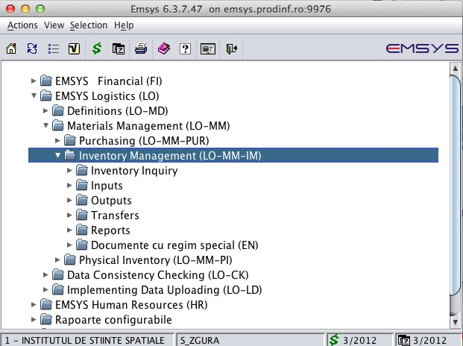
ERP – LO @ ISS
EMSYS Logistics controls in real time processes for Purchasing, Manufacturing, Sales and Inventory Management of goods, packing, raw material, materials, inventory small objects, protection and work equipments.
Sales and Distribution.
Manufacturing.
Purchasing.
ALOP(Commitment, Liquidation,
Ordering, and Payment)
Inventory Management.
Notes:
Sales and Distribution. Supports the management of contracts with efficient solving of demand for goods and services. Ensures actions' traceability for each stage of the sale process (negotiation, contracting, delivery, completion). There are functions for issuance of the pick lists, delivery orders and invoices, returns management and management of the sold and kept in custody goods. Flexible sale policies can be implemented on different levels: general, customer, store, item, by using price book, multiple units of measure, valuable and quantitative discounts, promotions, multiple currencies etc. Supplies in real time the stock available to a certain date (ATP – Available to Promise) for delivery optimization.
Manufacturing. Implements the main standard production strategies (MTO, MTS, ETO) and makes possible detailed defining of items: product structure (BOM), planning policies (LFL, POQ, FOQ), safety stock, technological operations and processes, technical data etc. Develops Master Production Schedule (MPS) by processing actual and forecast demand. It performs Material Requirement Planning (MRP) by generating work orders and purchase requisitions. Functions for product control take over the work orders to release, execute, control and report accomplishments. The system ensures the management of external operations.
Purchasing. Ensures the efficient management of the material requests for solving manufacturing, sales and office needs. The purchase orders centralize purchase requirement and constitute the legal base for goods and services receipt. Suppliers' invoices are recorded in the system distinctly from the receipt documents and are associated to them to establish quantity and price differences. There are functions for the returns management and management of the received in custody goods.
ALOP. For organizations that manage their expenses by budgets, EMSYS Logistics realizes purchase processes integration with the ALOP flow (Commitment, Liquidation, Ordering, and Payment). It contains functions to define and use CPV codes and Purchasing Schedule.
Retail. Realizes the sales and collection automation by the integration of the POS systems, cash registers and mobile devices. It contains functions for managing the price book, discounts, promotions, sale documents (orders, pick lists, delivery orders, receipts, and invoices).
Inventory Management. It has as purpose the quantitative-valuable evidence and analysis of inventory on warehouses, locations, lots, series, accounts, item groups/subgroups. It allows the configuration and usage of one of the inventory output methods, FIFO, LIFO or average cost, at global level or at item group level. All type of inventory transaction: inputs, outputs and transfers are available. Physical inventory is automated by integrating mobile devices. There are reports for inventory movements, checking and controlling, consumptions on cost centers, level of stocks, aging stocks analysis, inventory turnover etc

Slide 51

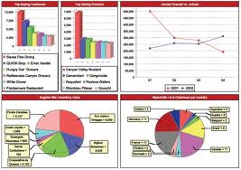
ERP – BI @ ISS
Financial Analysis
HR Analysis
Procurements Analysis
Planning, Budgeting and Forecasting
Profitability and Cost Management
Business Indicators
Notes:
BI & Performance Management module is an advanced solution for analysis and processing of performance indicators, which allows getting detailed reports and dashboards in an intuitive graphical way, based on performance indicators needed to support strategic decisions.
The module provides a set of tools designed to manage strategic, tactical and operational the business. By monitoring tools (dashboards and scorecards, graphs, drill down reports, data traffic lights, exceptions etc.) it accelerates managers' access to information and data.
Based on EMSYS' modelling instruments, we can obtain information on: profit centres, lines of business, organizational chart, business units, cost items, activities, profitability segments.
Reports are obtained directly from EMSYS database, without needing an ETL in a Data Warehouse.
EMSYS BI & Performance Management uses Jaspersoft Business Intelligence Suite.
Additional to EMSYS reports, users can conceive their own.

Slide 52
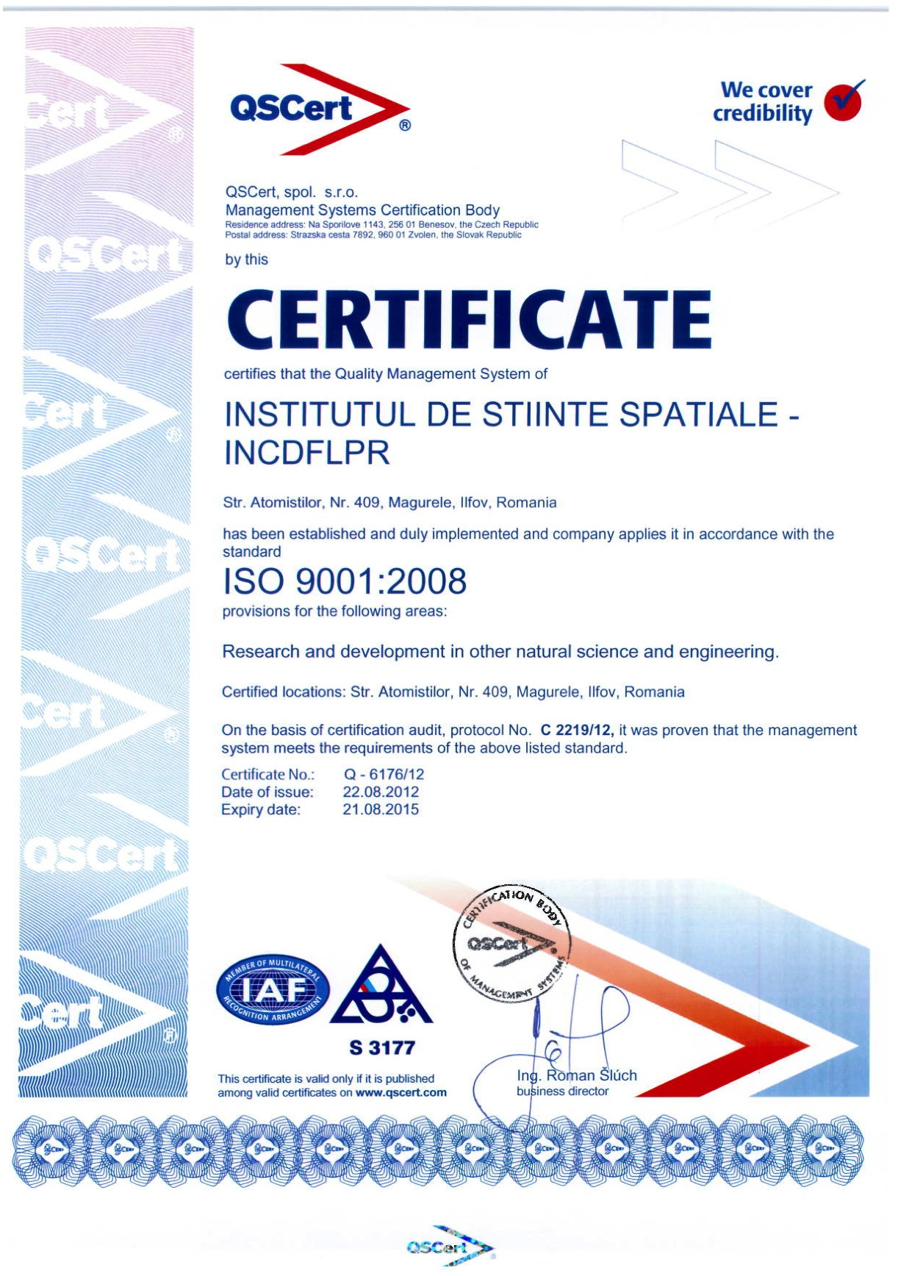
Operational Procedures @ ISS
The ISS participation in the ESA missions and critical Space and Security collaboration through National Critical Infrastructure requires:
ISO 9001:2008 Quality Management Systems
ISO 27001:2005 Information Security Management Systems (will start in 2013)
ISO 14001 Environmental Management System (will start in 2014)
Notes:
BI & Performance Management module is an advanced solution for analysis and processing of performance indicators, which allows getting detailed reports and dashboards in an intuitive graphical way, based on performance indicators needed to support strategic decisions.
The module provides a set of tools designed to manage strategic, tactical and operational the business. By monitoring tools (dashboards and scorecards, graphs, drill down reports, data traffic lights, exceptions etc.) it accelerates managers' access to information and data.
Based on EMSYS' modelling instruments, we can obtain information on: profit centres, lines of business, organizational chart, business units, cost items, activities, profitability segments.
Reports are obtained directly from EMSYS database, without needing an ETL in a Data Warehouse.
EMSYS BI & Performance Management uses Jaspersoft Business Intelligence Suite.
Additional to EMSYS reports, users can conceive their own.

Slide 53
Thank you very much!

Slide 54
What is the Instutional Development Plan for
next 4 years

Slide 55
MISSION AND VISION
For more than half a century, the Institute of Space Science (ISS) mission – under its various names and affiliations – has been to carry out fundamental and advanced scientific and engineering research in cosmic rays physics, high energy physics, astrophysics and the development of space technology and applications through national and international projects and collaborations. The ISS R&D policy has always been one of “covering all bases in the field”, from pure theory to data acquisition, processing and interpretation and from the drawing board to complex instruments and satellites operating in space as well as “terrestrial” applications of space assets.
As such, the ISS vision for the future is quite straightforward: to improve and expand Romanian participation to the worldwide efforts for the peaceful investigation of cosmic space and for the development of new technologies designed to improve the quality of life on our planet. We also consider it our mission to preserve and further develop Romanian space capabilities and expertise through excellence, efficiency and performance in leading-edge scientific research.

Slide 56
What is the Scientific SWOT Analysis

Slide 57
SCIENTIFIC SWOT ANALYSIS
Strengths
Position of national leadership in space science R&D activities.
Strong and broad scientific programs and research activities related to the preparation of Romania’s adhesion to the ESA (through PECS), as well as, after adhesion (at the end of 2011) the participation to ESA scientific and technology programs.
Strong and broad scientific programs and research activities in agreement with the National R&D plan.
Strong participation in international space programs (ESA, NASA), in major international institutes (CERN, JINR) and collaborations (BECQUEREL, ALICE, EUCLID, PLANCK, ANTARES, KM3NeT, Pierre Auger Observatory, FCAL, COST).
Strong national institutional partnerships with renowned universities (University of Bucharest, Bucharest, “Politehnica” University, etc) and institutes (IFIN-HH, INFLPR, INCDFM, etc) and companies.
Internationally renowned team leaders.
Top qualified research personnel with broad fields of expertise in astrophysics, cosmology, astroparticle physics, high-energy physics, theoretical and experimental gravity, space engineering and space activities management.
Well-developed research groups, capable to carry highly interdisciplinary projects.
Positive influx of young scientists trained abroad (EU, USA, Canada,etc).
Low age average of research personnel (~41 years).
A large number of peer-reviewed articles in highly scored ISI journals and other journals databases.
GRID and High performance computing (HPC) facilities and infrastructure (GRID, HPC, GPU and Cloud computing).
Availability of transfer-ready technologies for public, private and strategic partners.
Participation in the ESFRI supported projects (KM3NeT, FAIR, CERN, and EGI).
Strong involvement in the national high-school and university level education system (lectures, demonstrations, summer schools, M.Sc. and Ph.D. programs).

Slide 58
SCIENTIFIC SWOT ANALYSIS
Weaknesses
Lack of stronger dedicated technological and experimental infrastructure.
Lack of knowledgeable and experienced technical support personnel.
Absence of a coherent program for training managers of all levels in the institute.
Poor interest of Romanian technical and technological SME’s and companies that could capitalize on institute’s research results.
Low technical and technological level of Romanian companies that could capitalize on institute’s research results.
Poor availability of national high-tech companies interested in the transfer of advanced technology.
Insufficient number of young university graduates with proper background for a scientific and high-tech career.
Insufficient mass media exposure at the national and international level.

Slide 59
SCIENTIFIC SWOT ANALYSIS
Opportunities
Getting stronger integration in the R&D national and ESA space science programs.
Getting stronger presence in international R&D space and related science programs (FP7, ESA, CERN, NUSTAR-FAIR, GSI, and NASA).
Getting stronger implication in the national educational system at all levels.
Experience and achievements in applications concerning human space flight countermeasures, space for health and space for security with immediate potential of valorization at the level of international cooperation in space domain as well as at the level of terrestrial spin-off.

Slide 60
SCIENTIFIC SWOT ANALYSIS
Threats
National level: instability of Government’s science and research policies and practices which puts in jeopardy the long term development and human resources stability.
Regional level: competition from similar institutions in the former Eastern Bloc.
Ineffective purchasing and acquisition system, which is incompatible with a fast paced research environment.
Lack of legal framework to make private investments attractive to potential investors.

Slide 61
What are the Strategic Scientific Objectives and Directions?

Slide 62
STRATEGIC SCIENTIFIC OBJECTIVES AND DIRECTIONS
O1. Involvement in ground-based experiments of national and international interest.
D1.1 Neutrino astrophysics, multi-messenger astronomy with neutrinos, gamma and ultrahigh energy cosmic rays (participation at ANTARES, KM3NeT, DWARF, Pierre Auger Observatory).
D1.2 Search of exotic particles and phenomena in cosmic rays and colliders/accelerators beams (participation at ANTARES, KM3NeT, LHC-ALICE-CERN, MoEDAL – CERN, NUSTAR-FAIR-GSI, ILC, NICA-JINR DUBNA, NUCLOTRON-JINR DUBNA).
D1.3 Innovative particle detection techniques with applications to large scale ground-based experiments (e.g. FCAL).
D1.4 Search for astronomical and astrophysical signatures of Weak Equivalence Principle (WEP) violations.
Notes:
The main objectives of the ISS strategic development plan revolve tightly around its stated mission, namely that of further increasing its scientific performance, standing and recognition within the space science and technology community through participation in and initiation of national and international projects.
The strategic development plan is based on a core of 5 strategic objectives that emerge from the scientific SWOT analysis presented in the previous section. Each of these objectives is supported by appropriate key scientific activities which represent the milestones of the ISS future development.

Slide 63
STRATEGIC SCIENTIFIC OBJECTIVES AND DIRECTIONS
O2. Involvement in satellite space missions of international interest.
D2.1 Investigation of solar system plasmas by satellite observations (e.g. by participation to the ESA missions Cluster, Venus Express, Swarm, Solar Orbiter and to the NASA missions THEMIS and MMS).
D2.2 Participation to ESA scientific missions for the search of dark matter, dark energy and modified gravity (PLANCK, EUCLID, CoRE)
Notes:
The main objectives of the ISS strategic development plan revolve tightly around its stated mission, namely that of further increasing its scientific performance, standing and recognition within the space science and technology community through participation in and initiation of national and international projects.
The strategic development plan is based on a core of 5 strategic objectives that emerge from the scientific SWOT analysis presented in the previous section. Each of these objectives is supported by appropriate key scientific activities which represent the milestones of the ISS future development.

Slide 64
STRATEGIC SCIENTIFIC OBJECTIVES AND DIRECTIONS
O3. Involvement in the International Space Station
exploitation as a space platform for scientific and technological experiments.
Notes:
The main objectives of the ISS strategic development plan revolve tightly around its stated mission, namely that of further increasing its scientific performance, standing and recognition within the space science and technology community through participation in and initiation of national and international projects.
The strategic development plan is based on a core of 5 strategic objectives that emerge from the scientific SWOT analysis presented in the previous section. Each of these objectives is supported by appropriate key scientific activities which represent the milestones of the ISS future development.

Slide 65
STRATEGIC SCIENTIFIC OBJECTIVES AND DIRECTIONS
O4. Development of space science technology facilities.
D4.1 Development of satellite instrumentation.
D4.2 Development and integration of microsatellites for space applications (GOLIAT).
D4.3 Development of a competitive integrated satellite ground testing facility.
D4.4 Development of a competitive satellite missions and communication centre.
D4.5 Development of a comprehensive testing and simulation facility for human space flight countermeasures.
Notes:
The main objectives of the ISS strategic development plan revolve tightly around its stated mission, namely that of further increasing its scientific performance, standing and recognition within the space science and technology community through participation in and initiation of national and international projects.
The strategic development plan is based on a core of 5 strategic objectives that emerge from the scientific SWOT analysis presented in the previous section. Each of these objectives is supported by appropriate key scientific activities which represent the milestones of the ISS future development.

Slide 66
STRATEGIC SCIENTIFIC OBJECTIVES AND DIRECTIONS
O5. Development and improvement of a strong computational and theoretical infrastructure to support the strategic plan objectives:
D5.1 Development and improvement of large scale High Performance Computing (HPC) facilities for high energy physics, space science, astrophysics, and applications (e.g. GRID sites for the ALICE-CERN Collaboration, GPU computing, ESA-PLANCK, FAIR-NUFAR-GSI).
D5.2 Stronger involvement in the study and numerical modelling of complex processes and structures in theoretical astrophysics, gravitation, cosmology, and physics of the violent Universe.
Notes:
The main objectives of the ISS strategic development plan revolve tightly around its stated mission, namely that of further increasing its scientific performance, standing and recognition within the space science and technology community through participation in and initiation of national and international projects.
The strategic development plan is based on a core of 5 strategic objectives that emerge from the scientific SWOT analysis presented in the previous section. Each of these objectives is supported by appropriate key scientific activities which represent the milestones of the ISS future development.

Slide 67
STRATEGIC SCIENTIFIC OBJECTIVES AND DIRECTIONS
O6. Integration of the ISS activities in national and international space applications of social and strategic interest, with the possibility of technological transfer to public, private and strategic partners:
D6.1 Disaster management.
D6.2 Mobile, in-field, satellite communication telemedicine for critical situations response.
D6.3 Weather surveillance.
D6.4 Remote sensing.
D6.5 Countermeasures to human space flight in adverse conditions
Notes:
The main objectives of the ISS strategic development plan revolve tightly around its stated mission, namely that of further increasing its scientific performance, standing and recognition within the space science and technology community through participation in and initiation of national and international projects.
The strategic development plan is based on a core of 5 strategic objectives that emerge from the scientific SWOT analysis presented in the previous section. Each of these objectives is supported by appropriate key scientific activities which represent the milestones of the ISS future development.

Slide 68
Human Resources Strategy
Objectives:
To support the development and operation of the ISS as a research institute responsive to individual and organizational needs.
To provide high quality human resource services to the ISS scientific and non-scientific community.
To ensure the ISS fulfills its statutory and audit requirements.
To monitor organizational and individual performance.
To identify, promote and implement responsible social and economic policies and practices.
To introduce and support effective management systems, organisational structures and practices.
Notes:
The human resources management strategy comprises a set of policies and practices designed to maximize organizational integration, employee commitment, flexibility and quality of work. By examining the patterns of researchers’ careers and the effects of job changes and other critical issues on the job efficiency over time, we have decided on the following human resources management strategy:

Slide 69
Human Resources Strategy
A.1 Development and improvement of the quality and potential of human resources
Though thorough and performant hiring procedures and practices.
By providing flexible working hours for scientists involved in M.Sc. and Ph.D. programs.
By encouraging leading research scientists to apply for a position as PhD supervisors, certified by the Romanian Education and Science system.
By providing training and support for continuing education through workshops, courses and national and international postdoctoral fellowships.
By avoiding discrimination through legal equal opportunity practices and policies.
Through efficient and performant integration and reintegration of returning Romanian scientists and of those who were trained abroad.
Through thorough and fair personal evaluation and professional advancement criteria as established by law and by the Scientific Council.
By encouraging and supporting ISS collaborations with the academic and industrial environments.
By setting up an active outreach programs and policies to attract and recruit outstanding students from renowned Romanian Universities.
By setting up national and international exchange programs for students, postdoctoral fellows and scientists.
By encouraging and supporting the ISS research scientists to become members of international teams and collaborations and perform in highly demanding environments.
By setting appropriate policies for hiring outstanding scientists from abroad, especially team leaders.
By offering access to the ISS facilities to foreign scientists through national and international research and educational programs and collabotations.
Notes:
The human resources management strategy comprises a set of policies and practices designed to maximize organizational integration, employee commitment, flexibility and quality of work. By examining the patterns of researchers’ careers and the effects of job changes and other critical issues on the job efficiency over time, we have decided on the following human resources management strategy:

Slide 70
Human Resources Strategy
A.2 Improvement of management performance
Through efficient identification of staff development needs and implementation of appropriate programs supporting the areas of strategic interest.
By providing appropriate rewards and recognition for outstanding performance.
By providing flexible and efficient employment options.
By improving the administrative and human resource structure of the ISS.
By encouraging and developing the flexibility, multitasking abilities and problem solving skills of the ISS non-scientific staff.
By settting up and enforcing general and specific staff misconduct rules and policies.
Notes:
The human resources management strategy comprises a set of policies and practices designed to maximize organizational integration, employee commitment, flexibility and quality of work. By examining the patterns of researchers’ careers and the effects of job changes and other critical issues on the job efficiency over time, we have decided on the following human resources management strategy:

Slide 71
Mechanisms for Stimulating the Appearance of New Research Directions
(I) Participation in national and international projects and collaborations
By using the ISS experience and expertise to identify scientific and technological needs and opportunities at the national and international level and to provide timely and efficient solutions.
By using the ISS scientific track-record to propose and become involved in new cutting-edge R&D projects, partnerships and collaborations at the national and international level.
Notes:
Besides the strengthening of the existing research programs with proven scientific output, the ISS is determined to get involved in new and state-of-the-art scientific and technological activities at both the national and international levels, in accordance to its strategic development plan. The methods and mechanisms envisioned by the ISS to successfully achieve this goal can be summarized as follows:

Slide 72
Mechanisms for Stimulating the Appearance of New Research Directions
(ii) Participation in national and international educational activities
By strengthening the ISS involvement in national and international higher-education activities (e.g. B.Sc, M.Sc, Ph.D., postdoc and visiting scientists’ supervisory and exchange programs).
By improving and further developing outreach programs at all educational levels.
Notes:
Besides the strengthening of the existing research programs with proven scientific output, the ISS is determined to get involved in new and state-of-the-art scientific and technological activities at both the national and international levels, in accordance to its strategic development plan. The methods and mechanisms envisioned by the ISS to successfully achieve this goal can be summarized as follows:

Slide 73
Mechanisms for Stimulating the Appearance of New Research Directions
(iii) Improvement of research infrastructure
By creating a highly versatile computational user-facility based on the already existent ISS HPC network in order to provide the ISS scientists and those from other national and international research institutions with flexible and performant computational support.
By modernizing, improving and further developing the experimental capabilities of the ISS in order to broaden its range of technological expertise and to further open it to the national and international scientific and industrial market (e.g. space instrumentation and microsatellite development, fabrication and testing, integration of space technology complex applications, instrumentation and components for future ground based astroparticle physics experiments. ).
Notes:
Besides the strengthening of the existing research programs with proven scientific output, the ISS is determined to get involved in new and state-of-the-art scientific and technological activities at both the national and international levels, in accordance to its strategic development plan. The methods and mechanisms envisioned by the ISS to successfully achieve this goal can be summarized as follows:

Slide 74
Mechanisms for Stimulating the Appearance of New Research Directions
(iv) Improvement of the national and international visibility and scientific standing
By fostering the development of new national and international collaborations with other research institutes and universities.
By supporting the ISS research groups and individual scientists to disseminate the results of their scientific endeavors and to increase their national and international visibility through organization and participation to national and international conferences, workshops and lectures.
By providing the ISS scientists with access to the latest information in the field through performant journal subscription packages.
By encouraging and supporting the ISS scientists to publish the results of their research in highly ranked scientific journals (ISI ranked and otherwise).
By providing efficient integration in the ISS scientific activities for returning Romanian scientists.
By encouraging and supporting a sustained ISS quality exposure to the various types of national and international media (e.g. technical and scientific magazines, newspapers, radio and TV, internet publications and forums, social networks, etc).
Notes:
Besides the strengthening of the existing research programs with proven scientific output, the ISS is determined to get involved in new and state-of-the-art scientific and technological activities at both the national and international levels, in accordance to its strategic development plan. The methods and mechanisms envisioned by the ISS to successfully achieve this goal can be summarized as follows:

Slide 75
What Financial SWOT Analysis?

Slide 76
Financial SWOT Analysis
Strengths
Increasing number of national and international research contracts due to the high visibility, scientific standing and expertise of the ISS.
Current financial operational stability (salaries, taxes, suppliers).
No financial debt.
Admission of the ISS as a part of Romanian full ESA membership.
Availability of transfer-ready technologies.
Notes:
In order be able to achieve the proposed objectives for the development of the ISS, the strategic plan and its implementation mechanisms and methods must be financially sustainable. The detailed SWOT analysis performed by the ISS or this purpose shows the following trends:

Slide 77
Financial SWOT Analysis
Weaknesses
Lack of a significant supporting investment fund.
Delay in the completion of the new Center of Space Science and Technology (CSST), which has slowed down the technological development and endowment of the ISS.
Notes:
In order be able to achieve the proposed objectives for the development of the ISS, the strategic plan and its implementation mechanisms and methods must be financially sustainable. The detailed SWOT analysis performed by the ISS or this purpose shows the following trends:

Slide 78
Financial SWOT Analysis
Weaknesses
Lack of a significant supporting investment fund.
Delay in the completion of the new Center of Space Science and Technology (CSST), which has slowed down the technological development and endowment of the ISS.
Notes:
In order be able to achieve the proposed objectives for the development of the ISS, the strategic plan and its implementation mechanisms and methods must be financially sustainable. The detailed SWOT analysis performed by the ISS or this purpose shows the following trends:

Slide 79
Financial SWOT Analysis
Opportunities
Romania’s commitment to increase the research budget to 3% of the GNP by 2020
New R&D financing mechanisms (e.g. the Laboratory Twinning type of grant to be introduced by the ANCS in 2012 and the National Technology and Innovation Program).
Participation in the ESA scientific and technology programmes.
Participation in the ESA-approved newest research projects (e.g. EUCLID),
Participation in the international major projects CERN-ALICE, CERN-WLCG, FAIR-GSI and in the FCAL ILC International Collaboration.
Full involvement in the ANTARES and KM3NeT undersea neutrin
Notes:
In order be able to achieve the proposed objectives for the development of the ISS, the strategic plan and its implementation mechanisms and methods must be financially sustainable. The detailed SWOT analysis performed by the ISS or this purpose shows the following trends:

Slide 80
Financial SWOT Analysis
Threats
The continuation and possibly deepening of the present economic recession, which can jeopardize the R&D budget allocation at the national and international levels.
Rigid, cumbersome and bureaucratically extensive government funding policies and practices.
The Government’s science and research policies and practices of readjusting the funding for already awarded grants and projects.
Poor diversity and efficiency of high-tech equipment suppliers.
Lack of adequate legislation to attract private investors.
Notes:
In order be able to achieve the proposed objectives for the development of the ISS, the strategic plan and its implementation mechanisms and methods must be financially sustainable. The detailed SWOT analysis performed by the ISS or this purpose shows the following trends:

Slide 81
Financial SWOT Analysis
Threats
The continuation and possibly deepening of the present economic recession, which can jeopardize the R&D budget allocation at the national and international levels.
Rigid, cumbersome and bureaucratically extensive government funding policies and practices.
The Government’s science and research policies and practices of readjusting the funding for already awarded grants and projects.
Poor diversity and efficiency of high-tech equipment suppliers.
Lack of adequate legislation to attract private investors.
Notes:
In order be able to achieve the proposed objectives for the development of the ISS, the strategic plan and its implementation mechanisms and methods must be financially sustainable. The detailed SWOT analysis performed by the ISS or this purpose shows the following trends:

Slide 82
SCIENTIFIC SWOT ANALYSIS
Threats
National level: instability of Government’s science and research policies and practices which puts in jeopardy the long term development and human resources stability.
Regional level: competition from similar institutions in the former Eastern Bloc.
Ineffective purchasing and acquisition system, which is incompatible with a fast paced research environment.
Lack of legal framework to make private investments attractive to potential investors.

Slide 83
SCIENTIFIC SWOT ANALYSIS
The trends of the above financial SWOT analysis show that – barring a worst case scenario of national and international economic meltdown – the ISS is in good financial standing to carry out in full its strategic development plan through the proposed methods and mechanisms.

Slide 84
What : Investment Plan and Strategy?

Slide 85
Infrastructure: Investment Plan and Strategy
The goal of this plan is to ensure a coherent and smooth implementation of the mechanisms and actions proposed for the implementation of the 2012-2016 strategic development plan.
Under these circumstances, the ISS resource investment strategy is focused on the following specific objectives:
Increasing the ISS presence in the space science national and international research programs and collaborations.
Increasing the ISS visibility and scientific standing in the national and international space science community.
Further developing the ISS computational facilities.
Finalizing the construction of “the Space Science and Technology Center” building and getting it ready for operation.
Modernizing and improving the ISS technical and technological equipment.
Notes:
The main difficulty in implementing the above objectives of the investment plan is of course, the securing of adequate financial resources.
For objectives (1)-(3) & (5), the issue is less stringent, as the funding is ensured from either the currently ongoing research projects and collaborations or from the future ones. In particular, (5) will be funded both on a case-by-case basis through the financing of the various national and international projects that require such equipment as well as in a more organized manner and in accordance to the strategic development plan through appropriate national and international infrastructure development grants
Objective (4) is more problematic, as it would be preferable to be achieved in a single financing step, and hence would require a lump sum of grant money. The issue is mitigated by the fact that the construction of the CSST is nearly 85% complete, and finalizing it will require a more modest amount of money. The ISS plans to obtain the necessary financing through appropriate national and international grants and to render the building operational as soon as possible. If this funding effort proves to be unfruitful, other financing avenues will be sought out, e.g. through private investments or through the ISS overhead funds.

Slide 86
What about Technology Transfer and Attraction of Non-public Funds?

Slide 87
Technology Transfer and Attraction of Non-public Funds
Space weather surveillance and forecast
Light pollution monitoring
Cosmic shower detectors for educational uses
Critical situation response support for human health and security
Notes:
Several of the recent ISS national and international scientific endeavors of the ISS have been – and continue to be – concerned with the development of new and highly performant technology with an excellent potential for transfer towards the industry. A brief list of technologies that could readily be prepared for transfer towards hi-tech companies in the next four years can be summarized as follows:

Slide 88
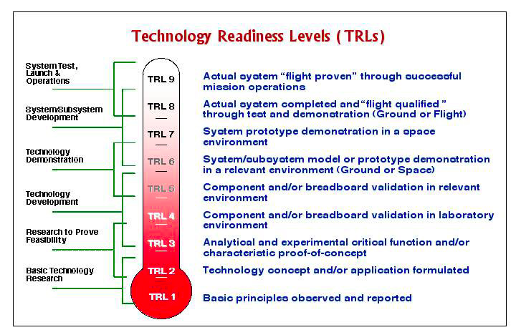
Technology Transfer and Attraction of Non-public Funds
Moreover, the ISS intends to take advantage of the National Technology and Innovation Program whose aim is to bring together consortia of research institutes and universities with the public and private sector for the development of a medium-term applied research program with significant social and economic impact. The ISS plans to use this program to develop a suitable network of potential non-public funding sources.

Slide 89
What about Strategic Partnerships and Visibility?

Slide 90
Strategic partnerships
National partnerships and collaborations:
Romanian Space Agency,
National Institute for Nuclear Physics and Engineering
National Institute for Laser, Plasma and Radiation Physics
National Institute for Material Physics
University of Bucharest.
SMURD
National Institute for Sports Research
Notes:
A strong research community is characterized by its global competitiveness and international attractiveness. The ISS is encouraging and actively supporting the establishment of strategic partnerships for research and technology development with national and international institutions. A list of the current ISS partnership and collaboration situation is presented below:

Slide 91
Strategic partnerships
International partnerships and collaborations
R3B Collaboration - FAIR, GSI, Darmstadt, Germany.
European Space Agency (ESA).
The Institute of Space Science could assume a leadership role in Romania during the implementation of the strategic partnership ROMANIA - ESA by participation in ongoing (Cluster, Planck, Venus Express) and upcoming (e.g. Swarm, Solar Orbiter, Euclid) ESA missions.
LHC - CERN, Geneva, Switzerland.
JINR Dubna, Russia.
FCAL-ILC (International Linear Collider).
ANTARES Collaboration
KM3NeT Consortium
Pierre Auger Observatory Collaboration.
Collaboration agreement between ISS and the Physics Department of the Bologna University, Italy
MEDES (CNES)
Notes:
A strong research community is characterized by its global competitiveness and international attractiveness. The ISS is encouraging and actively supporting the establishment of strategic partnerships for research and technology development with national and international institutions. A list of the current ISS partnership and collaboration situation is presented below:

Slide 92
Strategic partnerships
Bilateral government agreements
European Space Agency
CERN, Geneva, Switzerland
NUSTAR, GSI, Darmstadt, Germany
Joint Institute for Nuclear Research, Dubna, Russian Federation
Notes:
The analysis of our past and current partnership and collaboration portfolio shows that while the funds attracted through these partnerships and collaborations represent an important fraction of the ISS budget, they are by no means the only benefits. Through these partnerships and collaborations the ISS has been able to significantly increase its scientific standing and visibility in the space science community through the quality of research and developed technologies as well as through successful networking within and outside the EU.

Slide 93
Vizibility
ISS will increase the number and quality of scientific output in ISI ranked journals.
ISS visibility within the space science community is through the participation and organization of conferences, workshops, lectures and summer schools.
ISS will encourage and supported the scientists exposure to mass media attention
Production the media scientific content and disseminate thought (homepage, facebook, twiter, etc)
Notes:
It is a well-established fact that international visibility in science means publishing not just a large number of papers but rather high-quality papers. During the last decade, availability of resources as well as the national and international projects and collaborations have given a boost to the ISS in this respect, allowing its scientists to increase the number and quality of their scientific output in ISI ranked journals. Under these circumstances – and as part of the ISS strategy to improve its national and international visibility – it is of paramount importance that in the next four years all efforts be focused towards publishing in higher and higher ISI ranked journals.

Slide 94
What about ISS gratitude?

